Slide 1
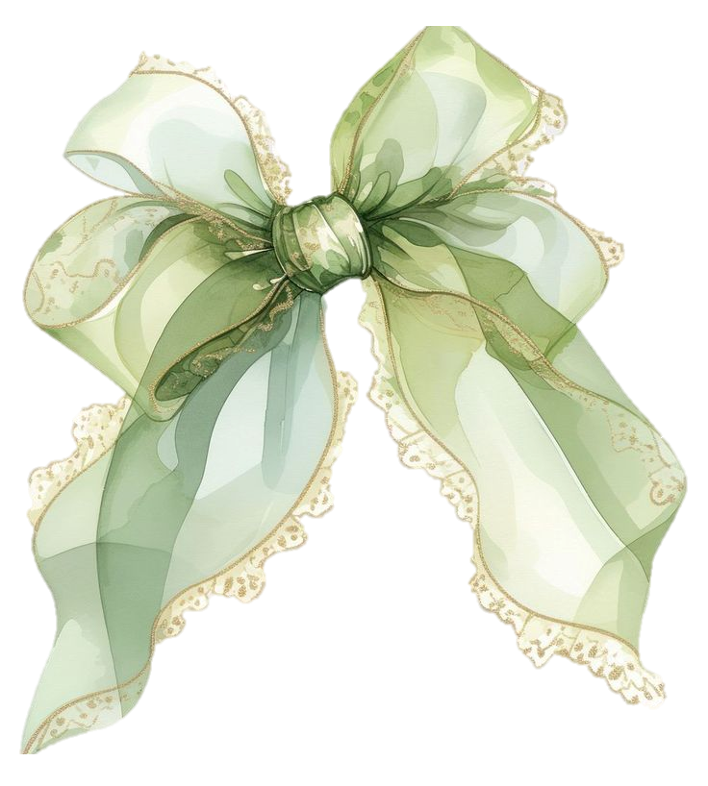
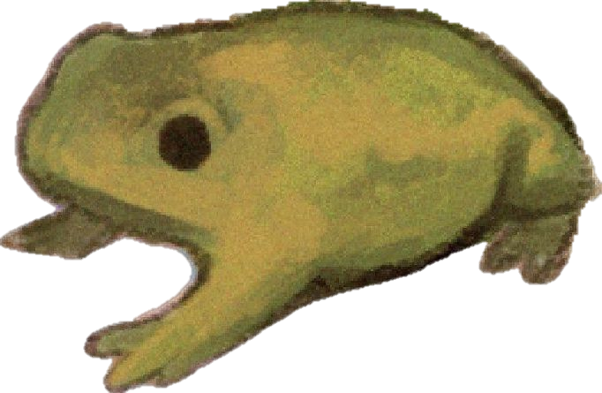

Slide 2
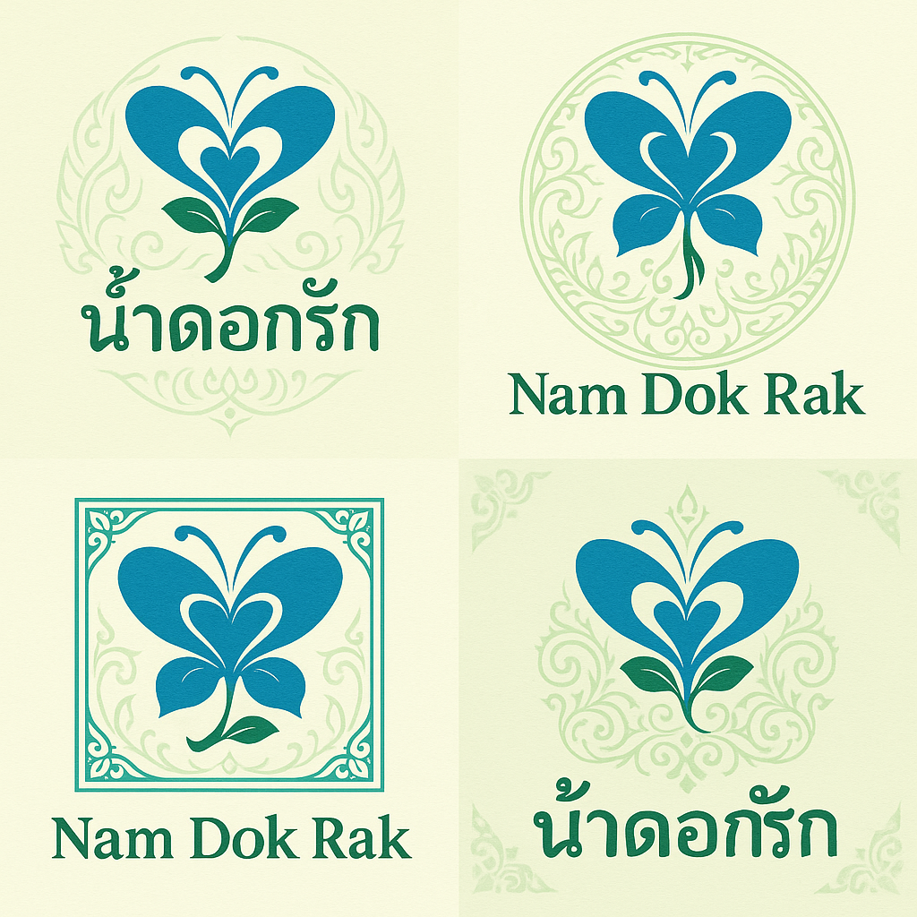
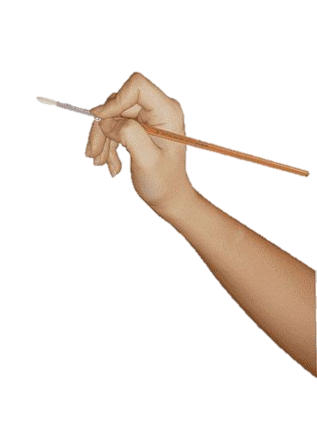
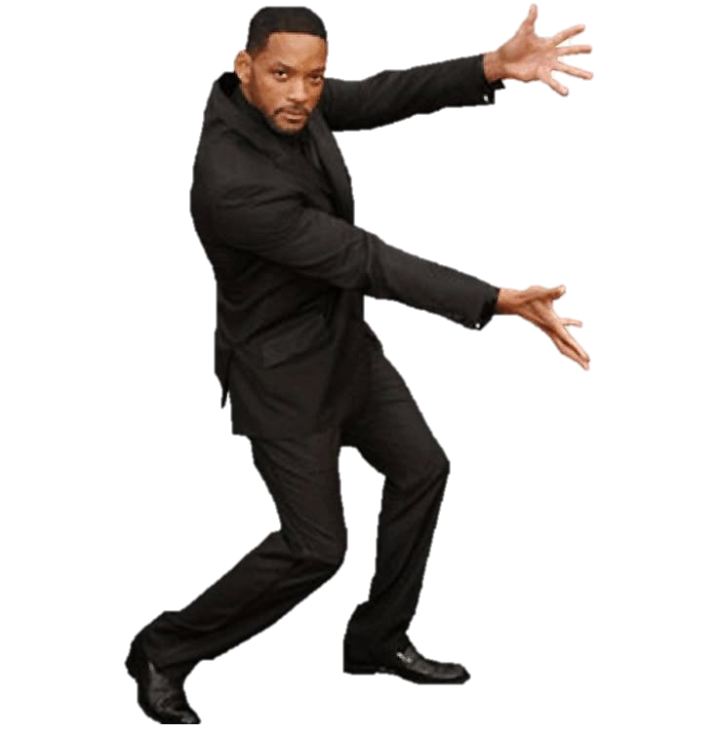

Slide 3
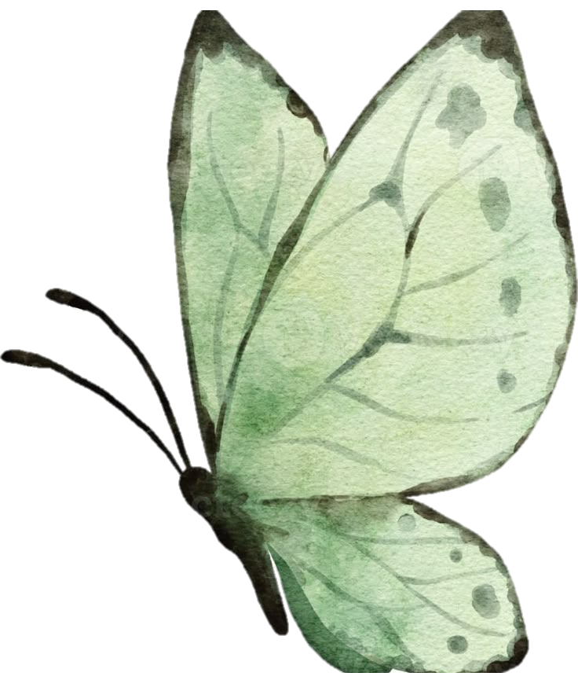
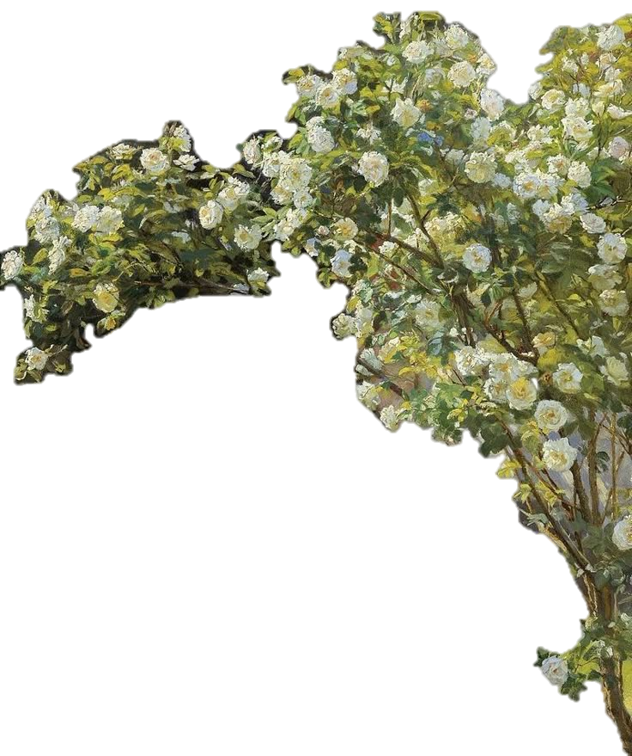
Product Description
A refreshing herbal drink made from Thai butterfly pea flowers, pandan leaves, and organic cane sugar, inspired by traditional Thai herbal wisdom

Slide 4
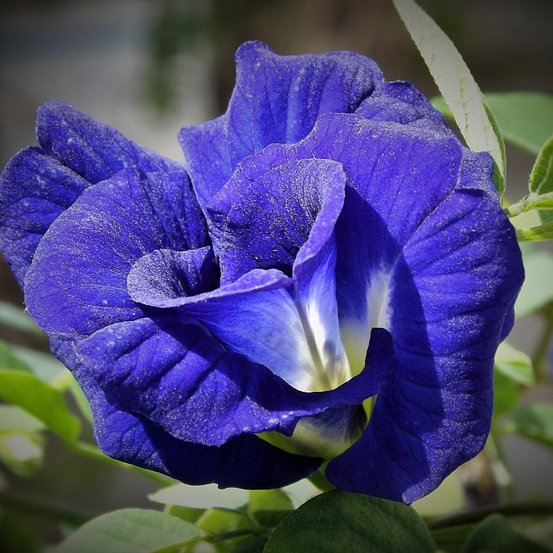
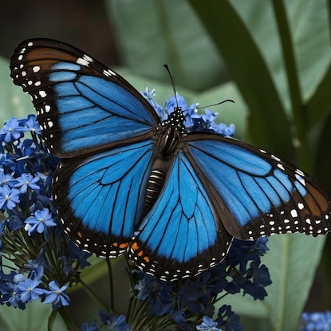
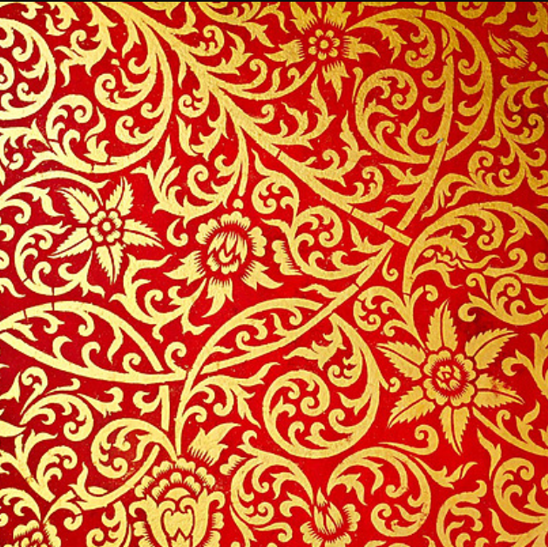
Logo Design Ideas
A blue butterfly (representing the butterfly pea flower)
A soft green background with Thai-style patterns

Slide 5
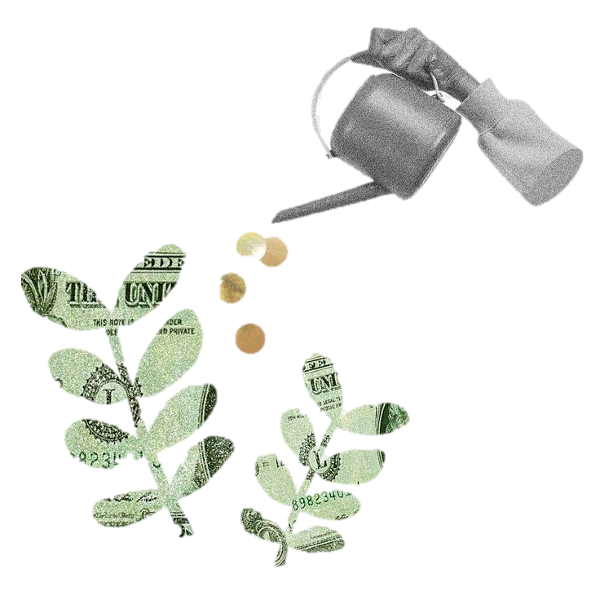
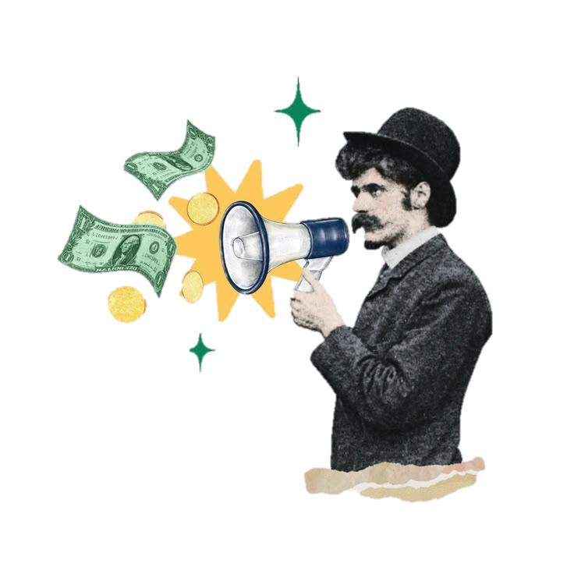
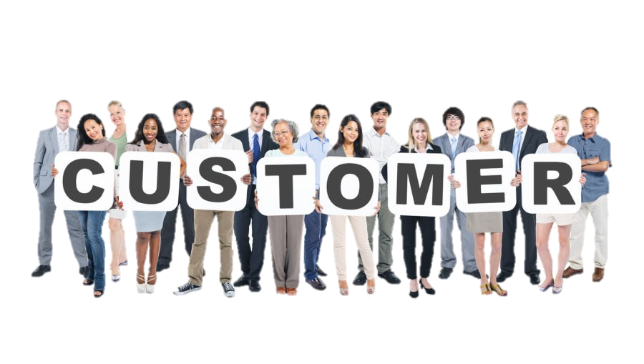
Marketing Target
Health-conscious consumers
Eco-friendly customers

Slide 6
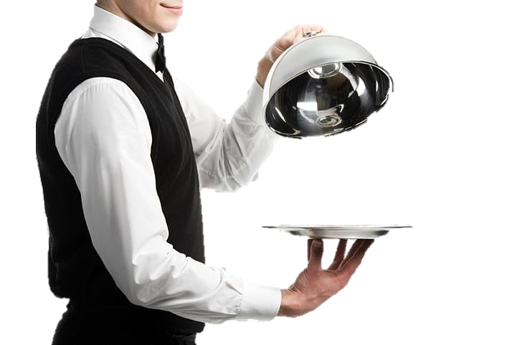
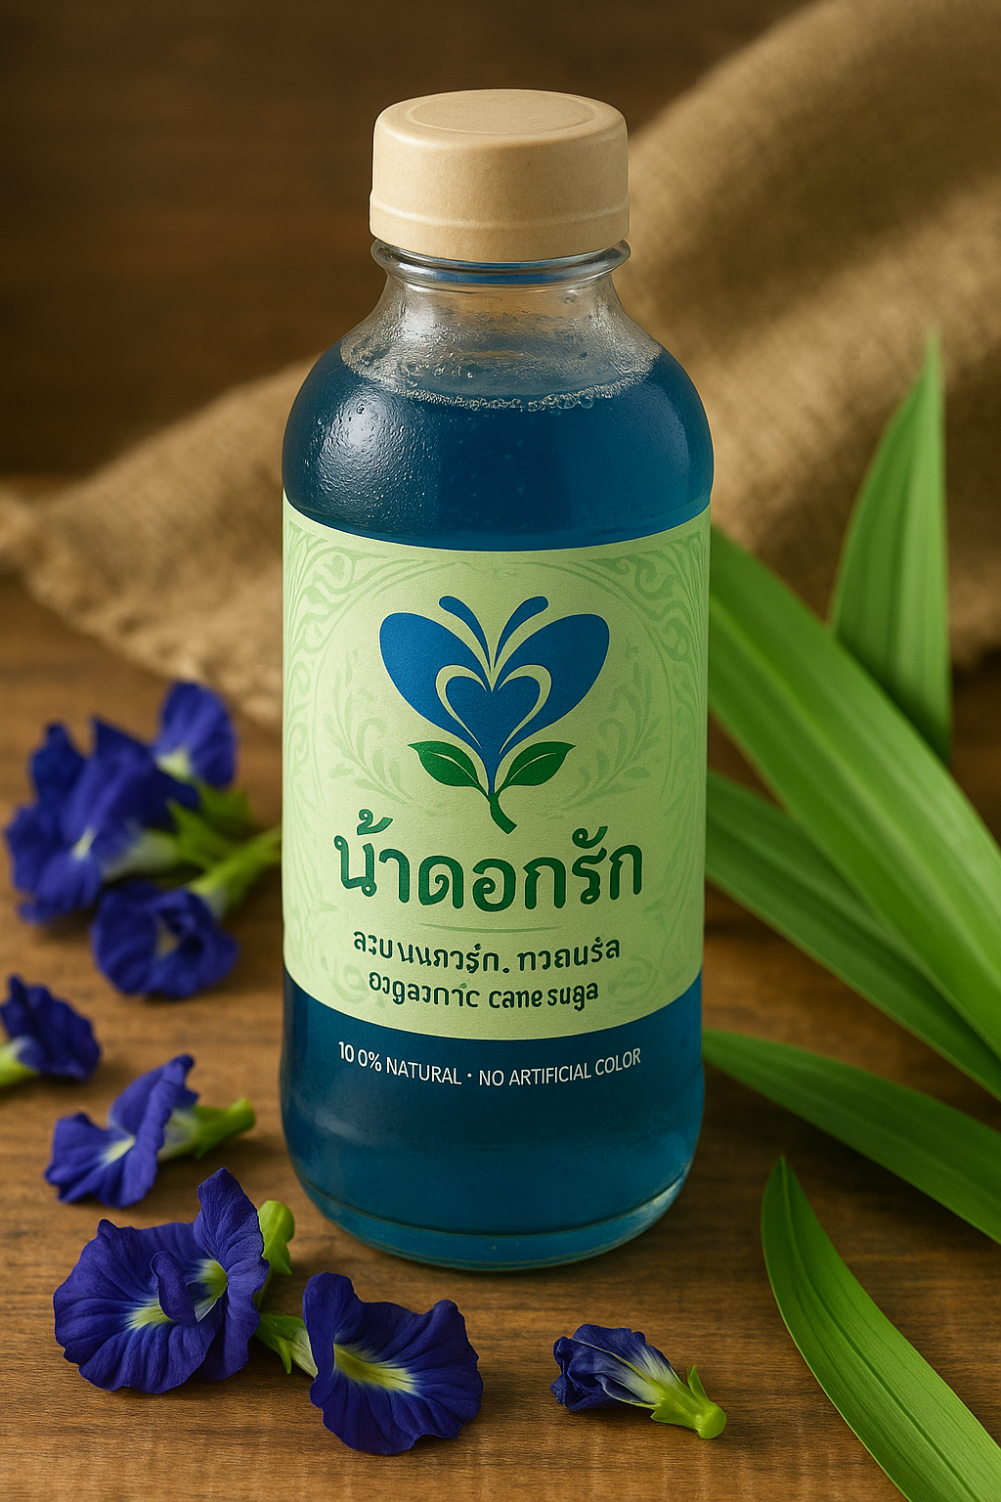
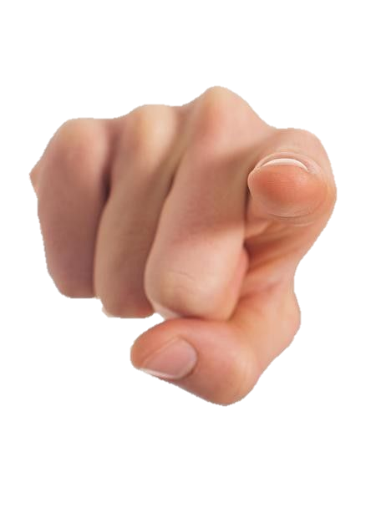
Product Highlights
100% natural, no artificial color
Traditional Thai herbal recipe
Promotes healthy skin and antioxidants

Slide 7

It’s your turn!
5-6 people for 1 group
1 product for 1 group
Do like the example
Present in front of the class

